Slide 1
Children Eucharistic Adoration in Parishes and Schools
As a necessary complement to Catechism: from knowing about Jesus to encountering him in his silent Eucharistic presence.

Slide 2
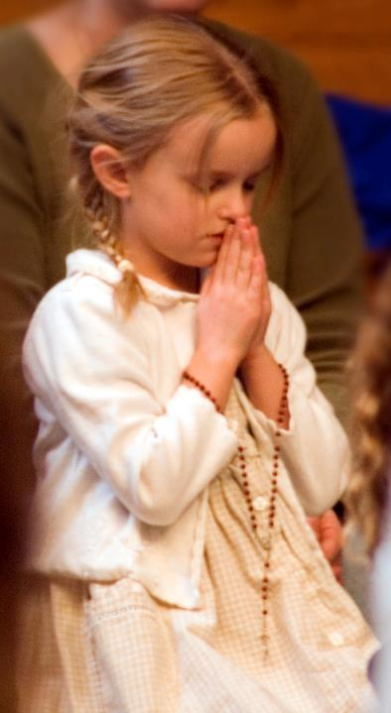
Are our catechism classes not enough to lead our children to know
Jesus Christ?

Slide 3
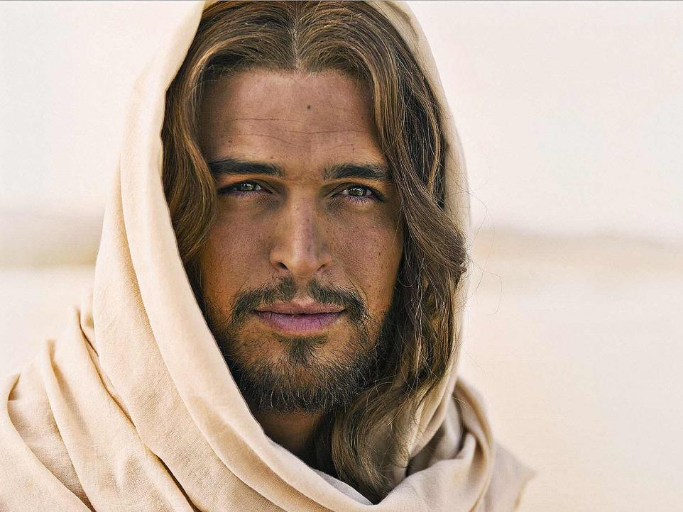
What does Jesus want?

Slide 4
“The hour is coming, and is now here, when the true worshippers will adore the Father in spirit and in truth, for the Father seeks such as these to worship Him”
John 4:23 24
“Let the children come to me and do not stop them, for it is to such as these that the kingdom of heaven belongs”
Mt 19:14

Slide 5
What does the church recommend?

Slide 6
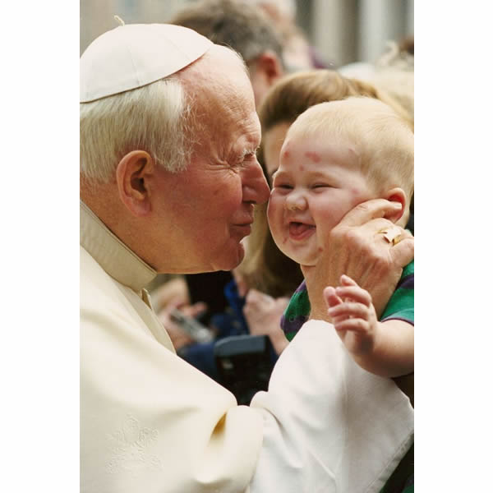
“I urge priests, religious and lay people to continue and redouble their efforts to teach the younger generations the meaning and value of Eucharistic adoration and devotion. How will young people be able to know the Lord if they are not introduced to the mystery of His presence?”
St. John Paul ll, 28 May 1996.

Slide 7
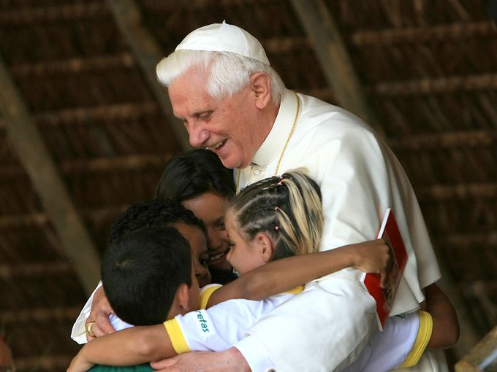
“I also recommend that in their catechetical training, and especially in their preparation for First Holy Communion, children be taught the meaning and the beauty of spending time with Jesus, and helped to cultivate a sense of awe before His Presence in the Eucharist”
Pope Benedict XVl, 13 March 2007.

Slide 8
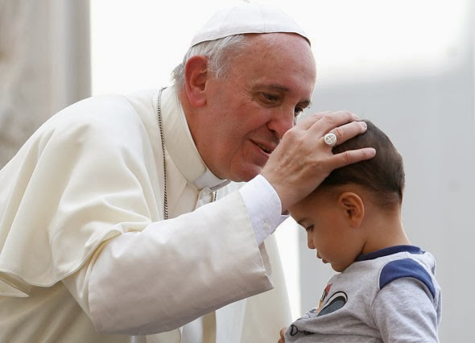
“The Eucharist is the sacrament of the communion that takes us out of our individualism so that together we live our discipleship, our faith in him”
Pope Francis 31 May 2013.

Slide 9
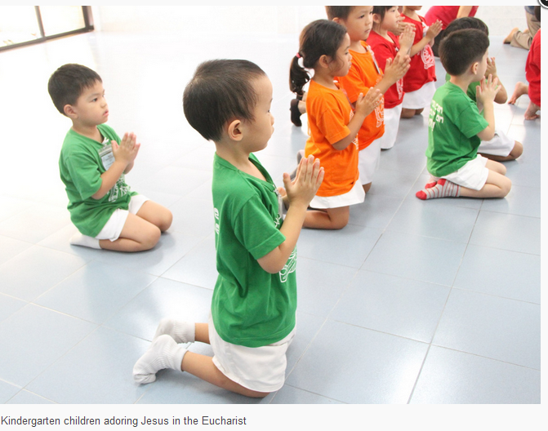
In Catechism classes we transmit the knowledge about God and Jesus´ life but do we lead children to encounter Jesus personnaly?
Fr. Antoine

Slide 10
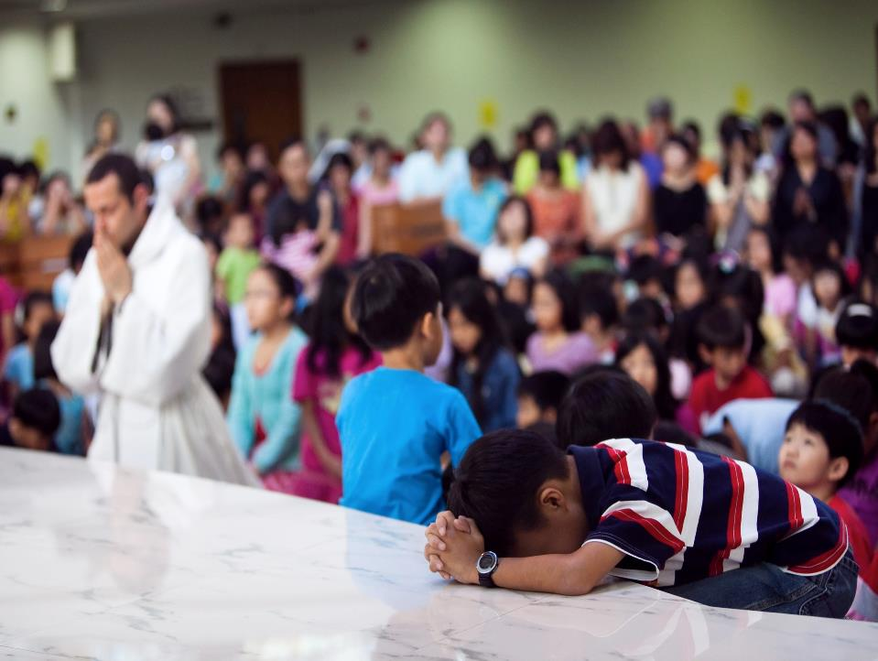
This is why leading children to discover the living presence of Jesus in Adoration is the complementary experience of Jesus outside the classroom.

Slide 11
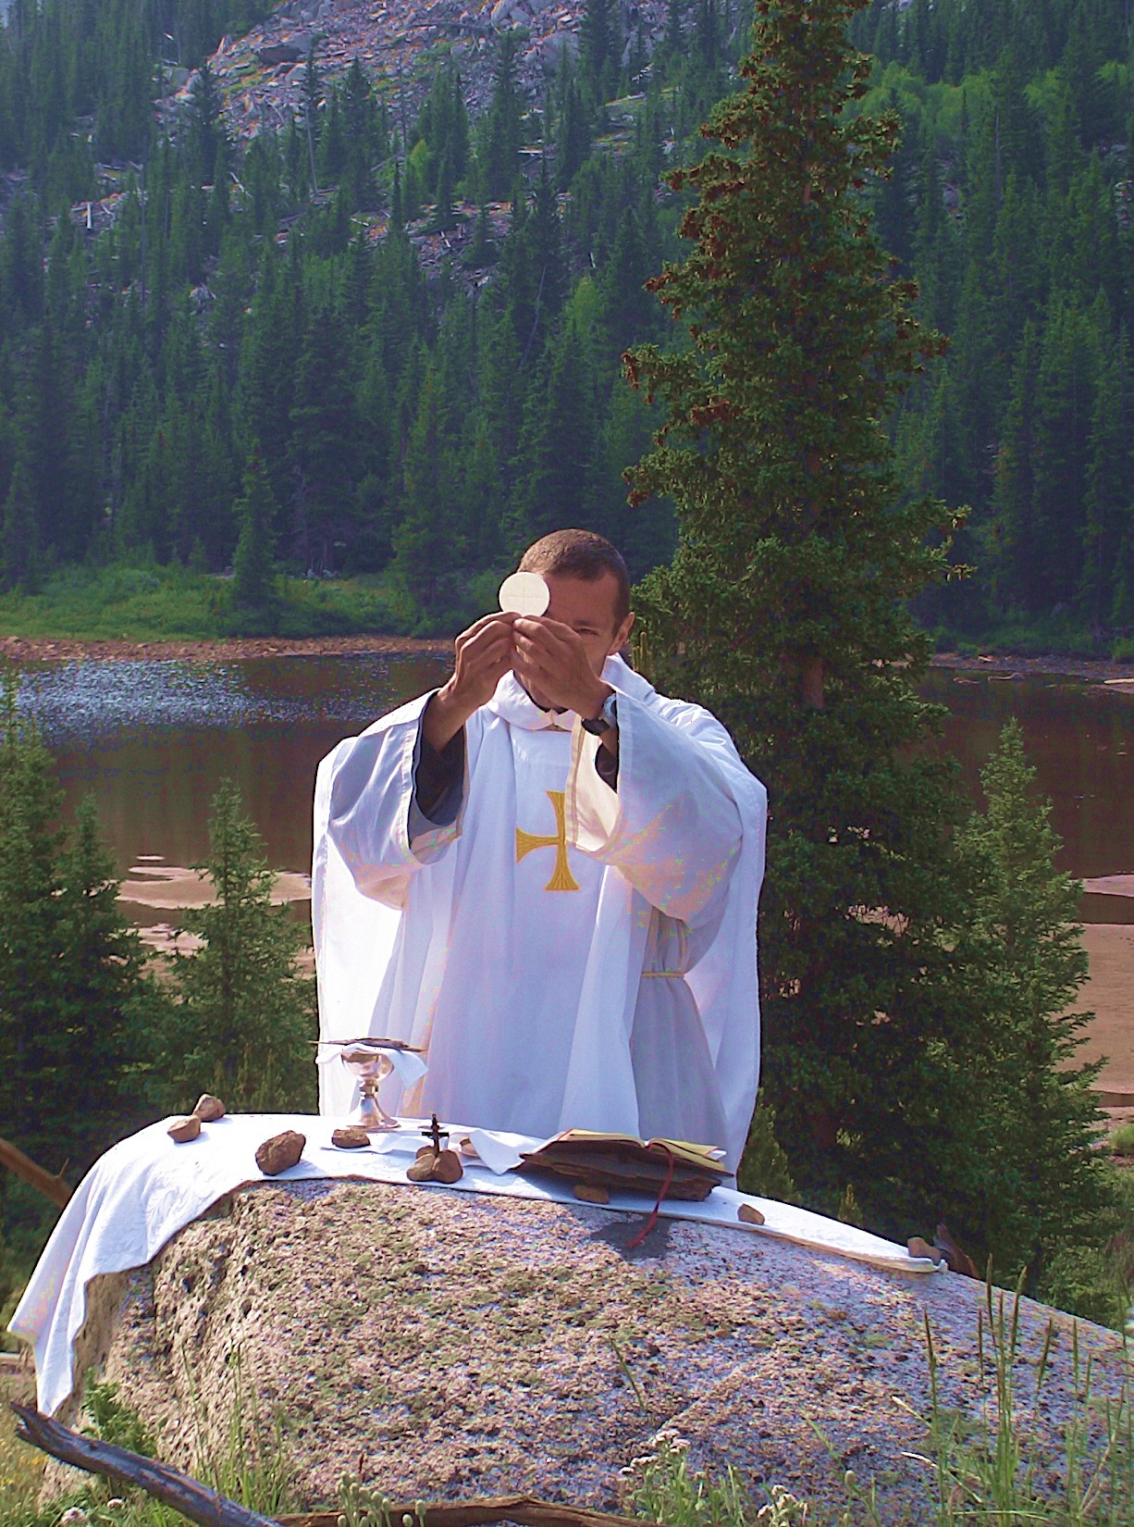
“Our communal worship at Mass must be together with our personal worship of Jesus in Eucharistic Adoration in order that our love may be complete”
(St. John Paul II, Sept 20, 1979. Ireland)

Slide 12
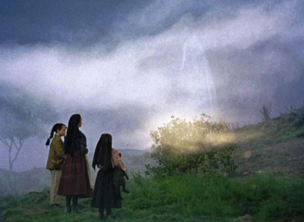
In 1916 God sent an angel to Fatima, Portugal, to teach children the adoration of God

Slide 13
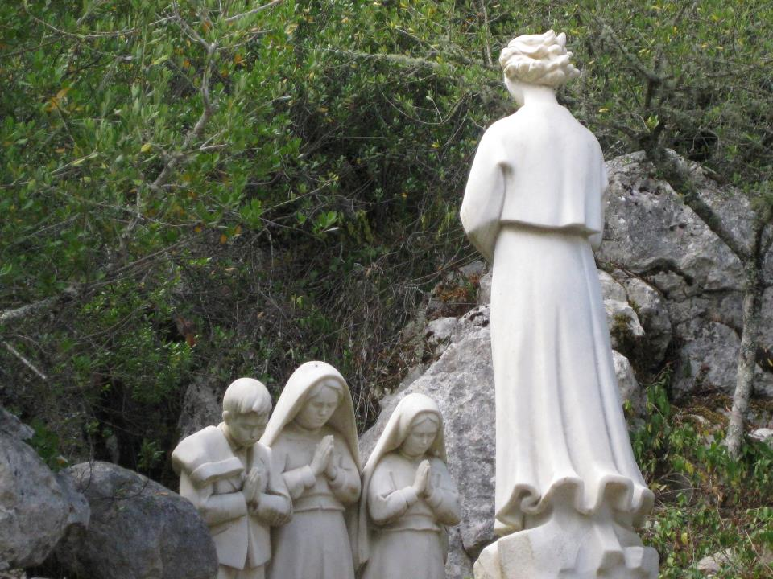
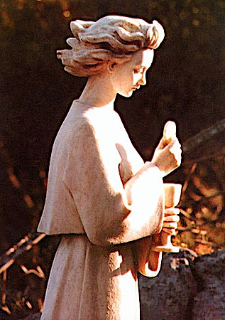
It is on the 3rd apparition that the angel taught them to adore Jesus in the Holy Eucharist and the Holy Trinity.

Slide 14
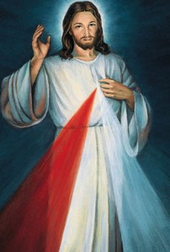
Revelation to Sister Faustina
On the sixth day of the
Novena of Divine Mercy
“Today bring to Me the Meek and Humble Souls and the Souls of Little Children, and immerse them in My mercy. These souls most closely resemble My Heart. They strengthened Me during My bitter agony. I saw them as earthly Angels, who will keep vigil at My altars. I pour out upon them whole torrents of grace. I favor humble souls with My confidence. ”

Slide 15
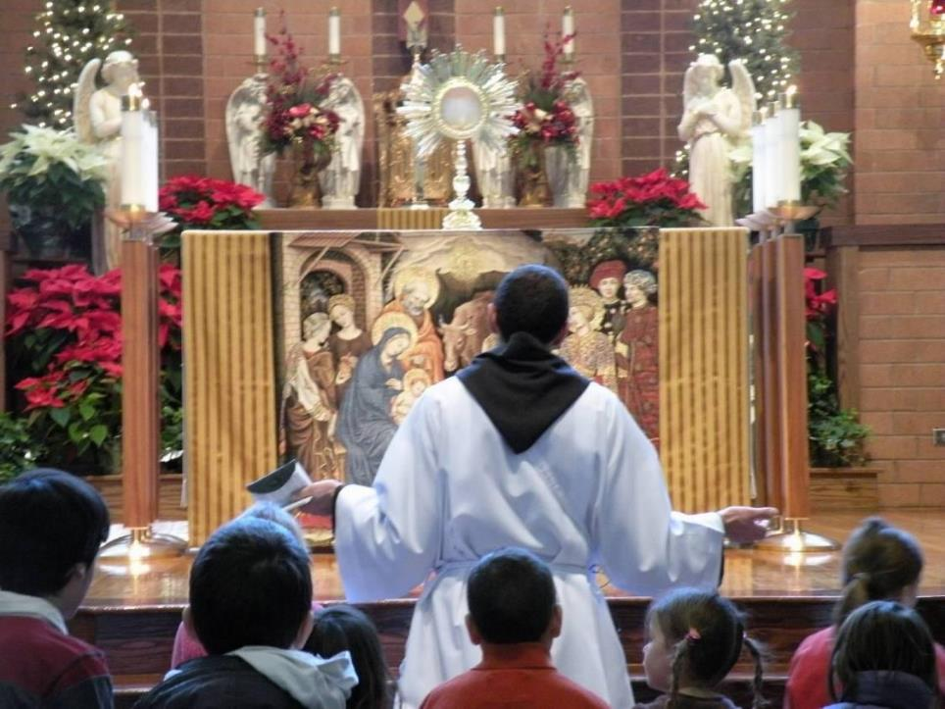

Slide 16
Prayer taught on the 1st Apparition
My God, I believe, I adore, I hope, and I love You.
I beg pardon for those who do not believe, do not adore, do not hope, and do not love You.
Amen.

Slide 17
Prayer taught on the 3rd Apparition
Oh Most Holy Trinity, Father, Son, and Holy Spirit, I adore you profoundly. I offer you the most precious Body, Blood, Soul and Divinity of Jesus Christ, present in all the tabernacles of the world, in reparation for the outrages, sacrileges and indifferences by which He is offended. By the infinite merits of the Sacred Heart of Jesus and the Immaculate Heart of Mary, I beg the conversion of poor sinners.
Amen.

Slide 18
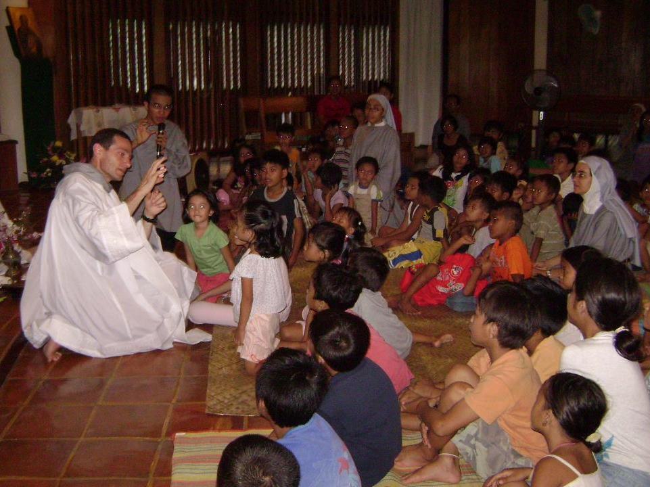
Would you like to introduce Eucharistic Adoration to children in your schools and in your parishes?

Slide 19
Steps:
Build a core team of motivated parents, priests, and catechists.
Watch the clip on : Children Adoration Ministry
School Adoration: organize with the Principal, Director of Religious Education and the Parish Priest a schedule to allow half an hour experience of Adoration every week or every fortnight.
Parish Adoration: contact the priest to arrange a special time for children and family adoration, if possible every month.
Suggested format: 3 minutes introducing silent adoration, 3 minutes of silent Adoration, 3 minutes of adoration song to help children adore, 3 minutes of reading from the words of Jesus ( Gospel ), 3 minutes of teaching on the Holy Eucharist. (Repeat 1 or 2 more times)
Blessing of children with the monstrance before Reposition.

Slide 20
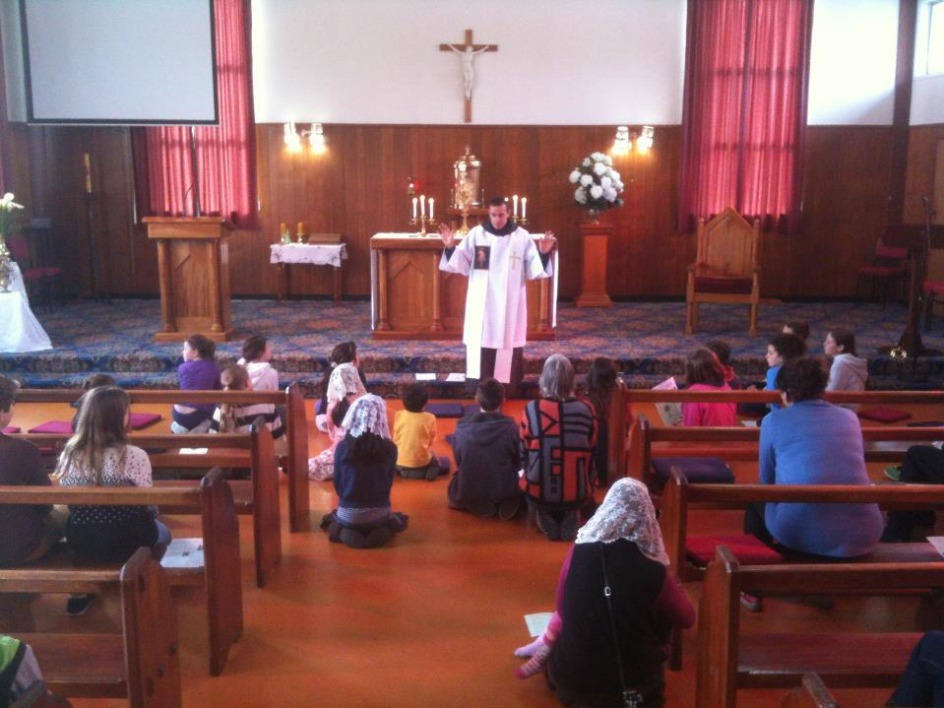
3 minutes introducing silent adoration

Slide 21
3 minutes of silent Adoration…

Slide 22
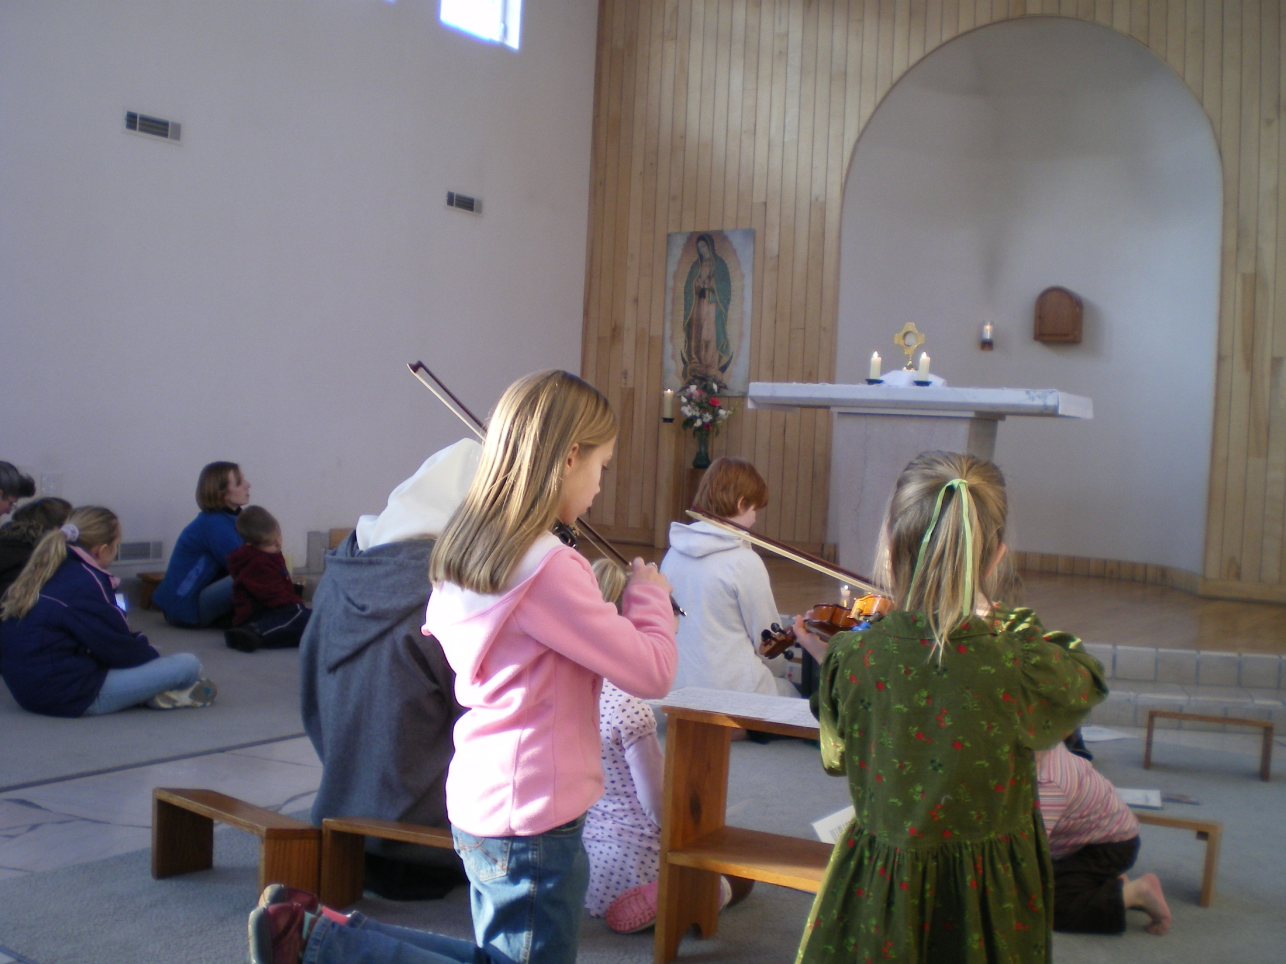
3 minutes of adoration song to help children adore

Slide 23
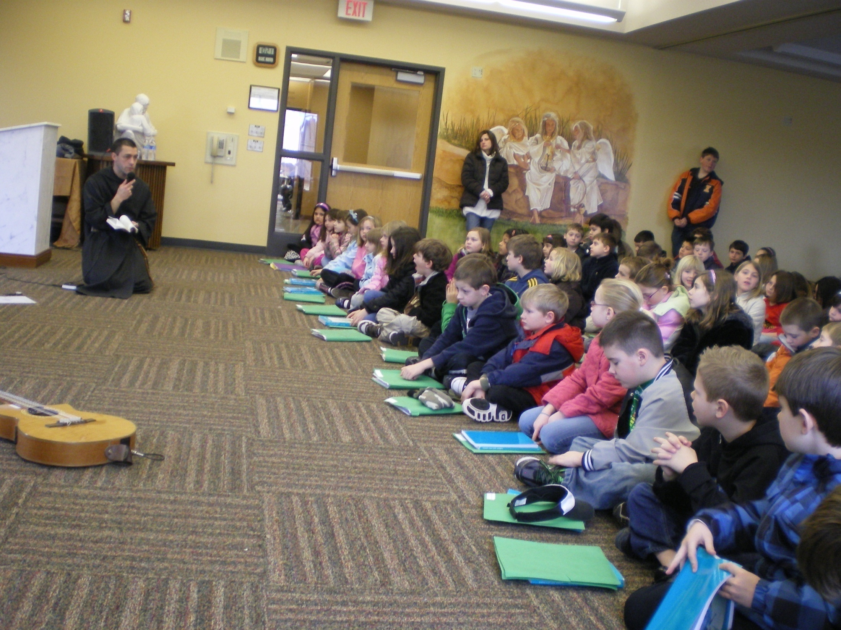
3 minutes of reading from the words of Jesus (Gospel)

Slide 24
3 minutes of teaching on the Holy Eucharist

Slide 25
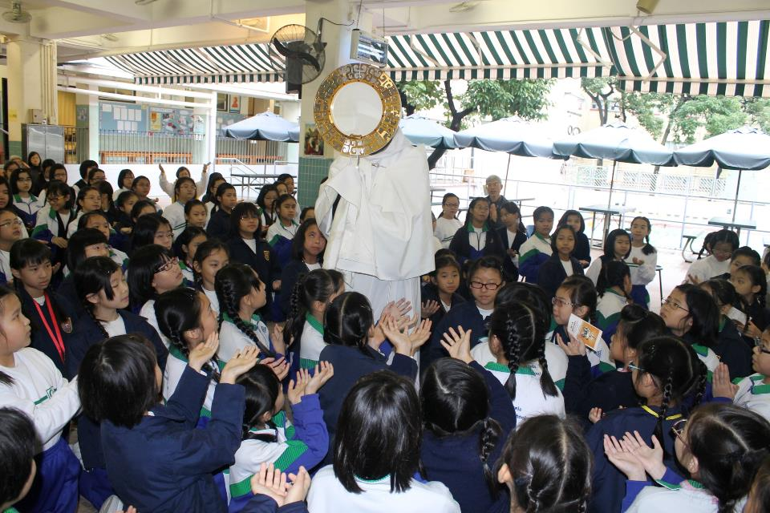
Blessing of children

Slide 26
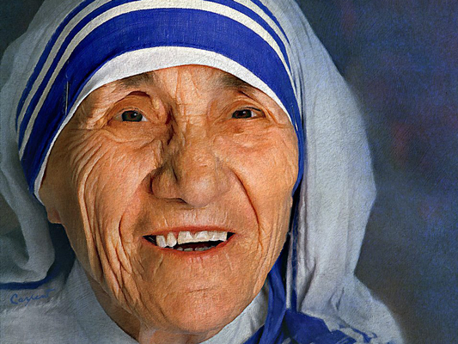
3 minutes of soft music to let children adore
"When you look at the crucifix, you understand how much Jesus loved you. When you look at the Sacred Host you understand how much Jesus loves you now. This is why we need Perpetual Eucharistic Adoration in every Parish throughout the entire World.”
Bl. Mother Teresa Calcutta

